Slide 1
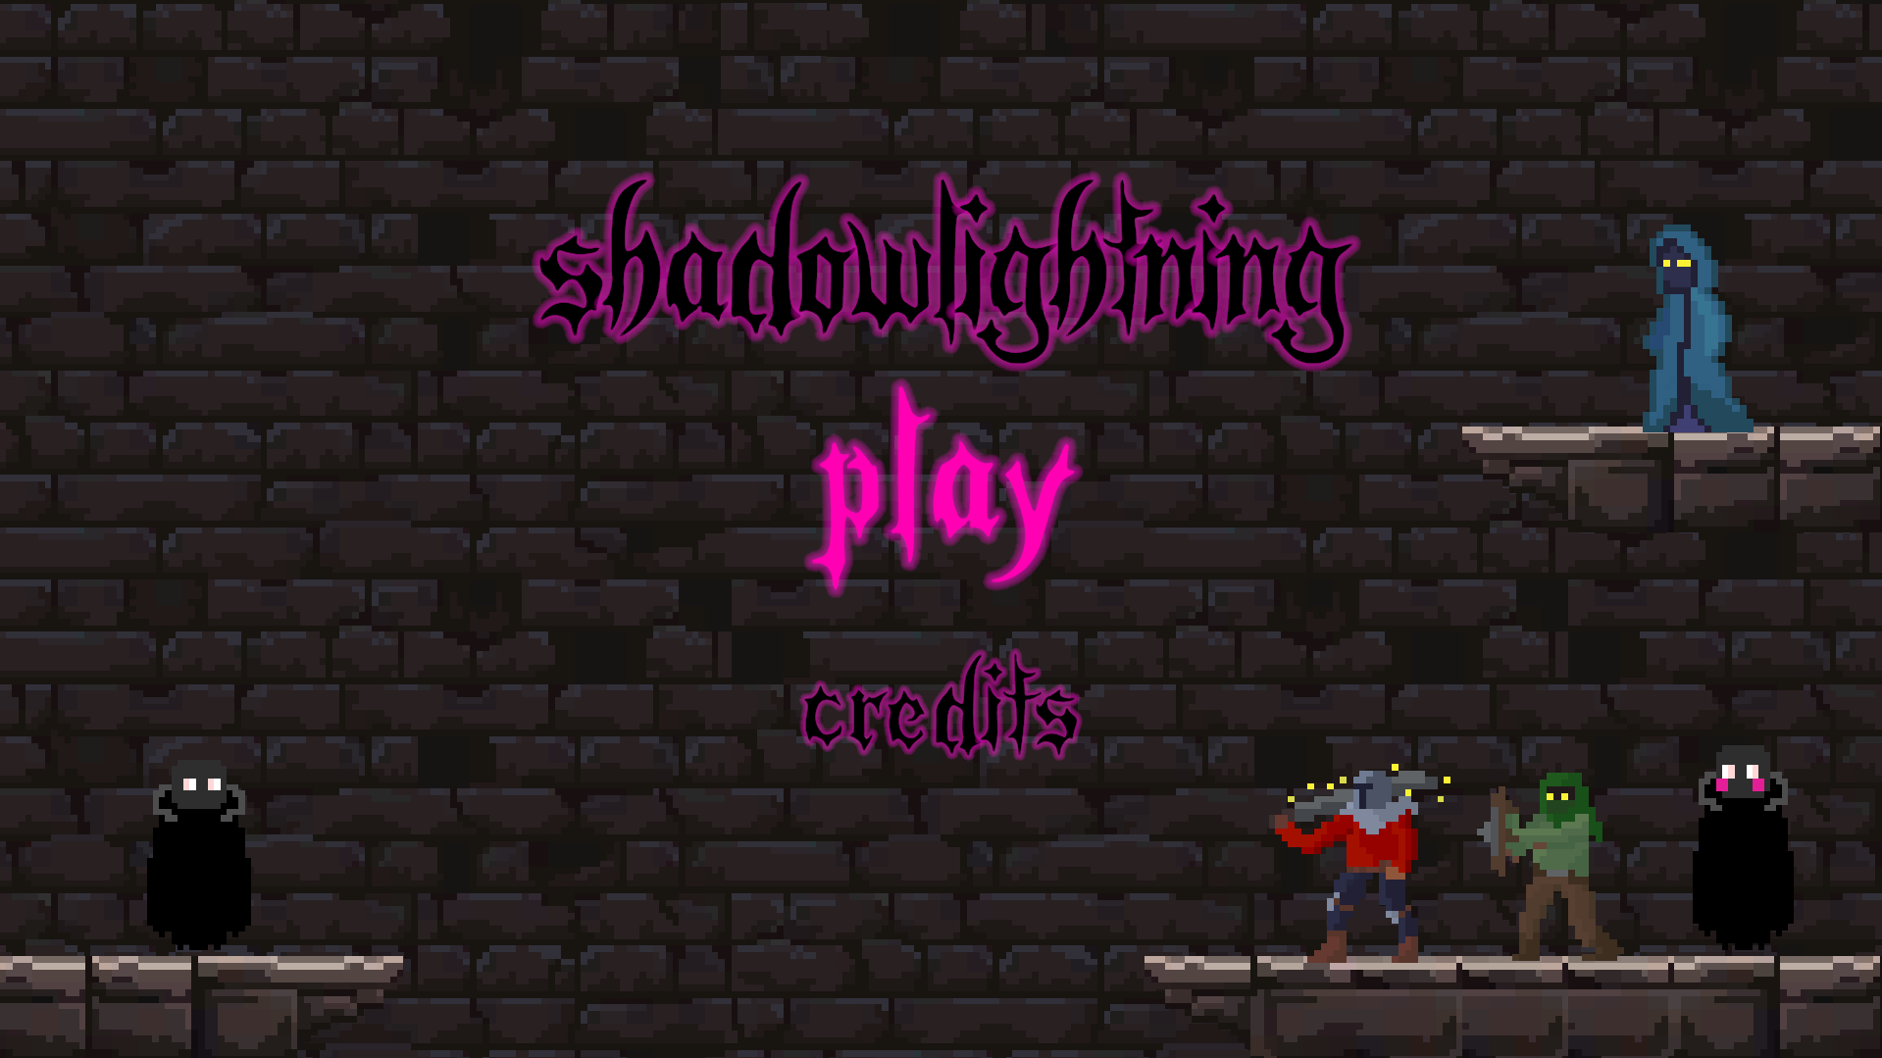

Slide 2
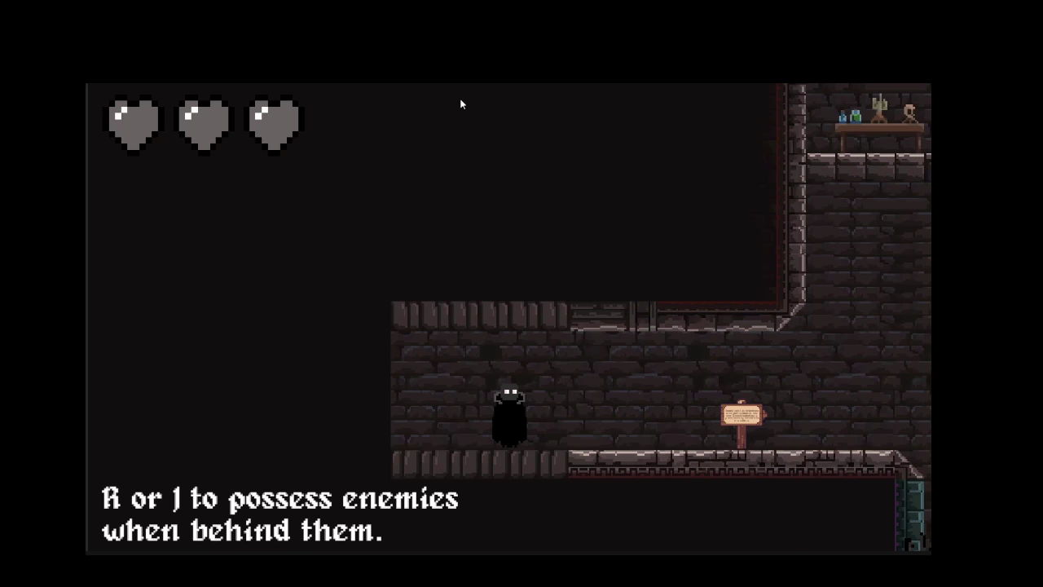
In Shadow Lightning you…
Possess enemies
Fight through tough combats
Do platforming
Solve puzzles

Slide 3
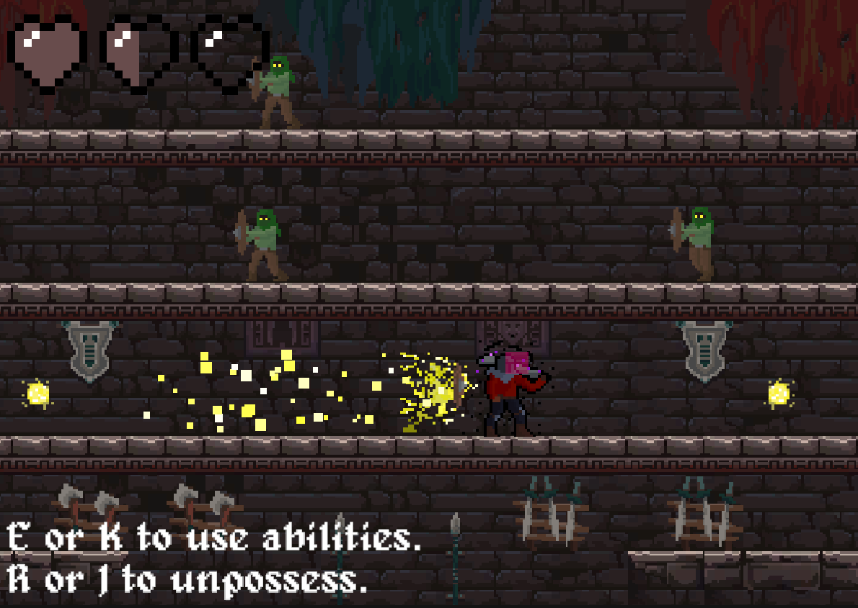
Setting and Theme
Dark, edgy, ancient temple setting
Lightning temple
Dark fantasy

Slide 4
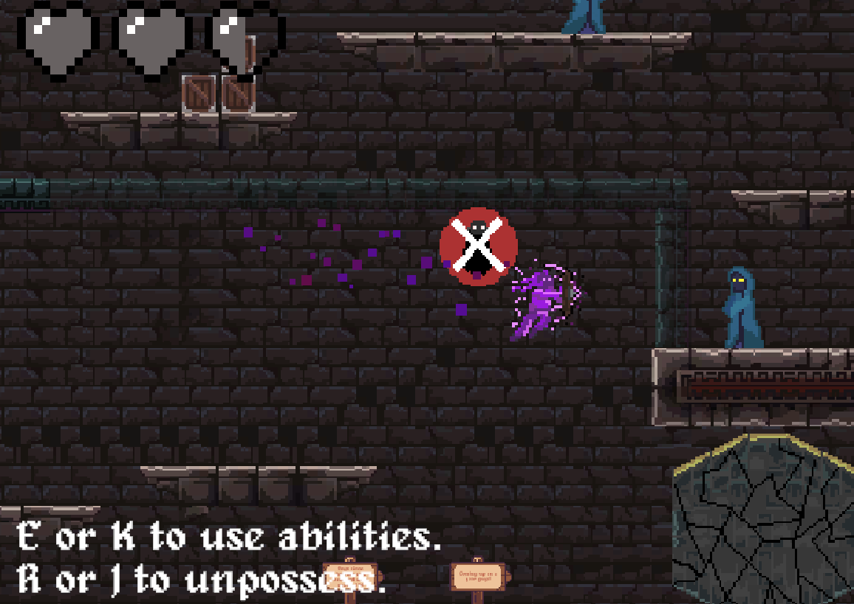
Playing Shadow Lightning…
… gives you a challenging obstacle to overcome
… has you in awe over the amazing pixel art.
… feels incredibly rewarding
… feels satisfying to play

Slide 5
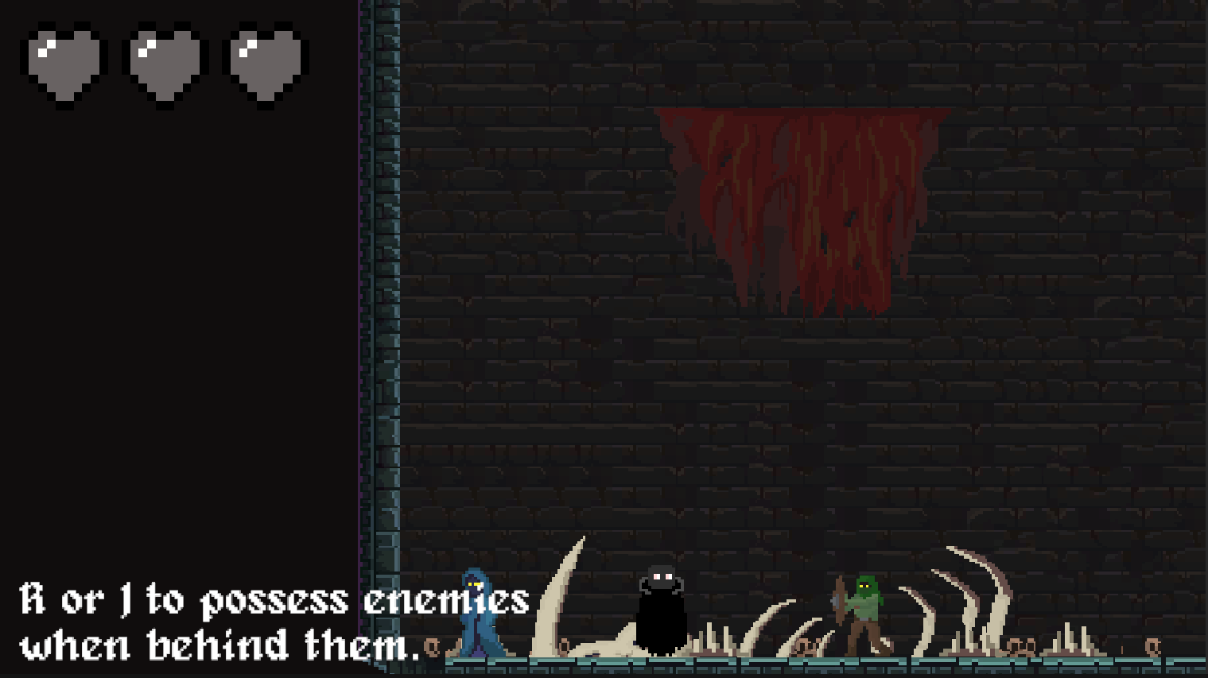
Player Experience
Make interesting choices
Challenge
Entertainment
Immersion

Slide 6

Players love Shadow Lightning!
On the new and popular page on itch.io the day after it was officially released (today)
“I LOVE the mechanics of Shadow Lightning” - Anonymous playtester
“WOW! Greatest game I've ever played”
- Comment on itch.io
“I really like the music”
- Anonymous playtester

